Slide 1
ML - Supervised Regression Models
By
Daniel Jadi
Data Scientist

Slide 2
1. Linear Regression
Linear regression is a statistical model that examines the linear relationship between two (Simple Linear Regression ) or more (Multiple Linear Regression) variables — a dependent variable and independent variable(s).
Dependent variable (aka criterion variable) is the main factor you are trying to understand and predict.
Independent variables (aka explanatory variables, or predictors) are the factors that might influence the dependent variable.
Regression analysis helps you understand how the dependent variable changes when one of the independent variables varies and allows to mathematically determine which of those variables really has an impact.
Regression analysis model is based on the sum of squares, which is a mathematical way to find the dispersion of data points. The goal of a model is to get the smallest possible sum of squares and draw a line that comes closest to the data.

Slide 3
In statistics, they differentiate between a simple and multiple linear regression. Simple linear regression models the relationship between a dependent variable and one independent variables using a linear function. If you use two or more explanatory variables to predict the dependent variable, you deal with multiple linear regression. If the dependent variable is modeled as a non-linear function because the data relationships do not follow a straight line, use nonlinear regression instead.
Linear regression equation
Mathematically, a linear regression is defined by this equation:
y = bx + a + ε
Where:
x is an independent variable.
y is a dependent variable.
a is the Y-intercept, which is the expected mean value of y when all x variables are equal to 0. On a regression graph, it's the point where the line crosses the Y axis.
b is the slope of a regression line, which is the rate of change for y as x changes.
ε is the random error term, which is the difference between the actual value of a dependent variable and its predicted value.

Slide 4
Interpret regression analysis output
1. Regression analysis output: Summary Output
Multiple R. It is the Correlation Coefficient that measures the strength of a linear relationship between two variables. The correlation coefficient can be any value between -1 and 1, and its absolute value indicates the relationship strength. The larger the absolute value, the stronger the relationship:
1 means a strong positive relationship
-1 means a strong negative relationship
0 means no relationship at all
R Square. It is the Coefficient of Determination, which is used as an indicator of the goodness of fit. It shows how many points fall on the regression line. The R2 value (0 to 1) is calculated from the total sum of squares, more precisely, it is the sum of the squared deviations of the original data from the mean.
Generally, R Squared of 95% or more is considered a good fit.

Slide 5
Adjusted R Square. It is the R square adjusted for the number of independent variable in the model. You will want to use this value instead of R square for multiple regression analysis.
Standard Error. It is another goodness-of-fit measure that shows the precision of your regression analysis - the smaller the number, the more certain you can be about your regression equation. While R2 represents the percentage of the dependent variables variance that is explained by the model, Standard Error is an absolute measure that shows the average distance that the data points fall from the regression line.
Observations. It is simply the number of observations in your model.

Slide 6
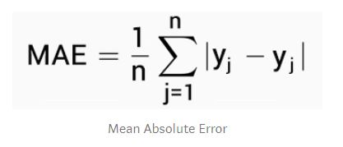
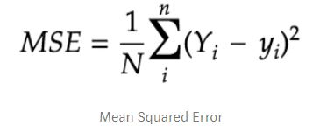
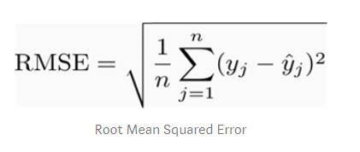
For regression algorithms, three evaluation metrics are commonly used:
Mean Absolute Error (MAE) is the mean of the absolute value of the errors. It is calculated as:
Mean Squared Error (MSE) is the mean of the squared errors and is calculated as:
Root Mean Squared Error (RMSE) is the square root of the mean of the squared errors:

Slide 7
Assumptions in Linear Regression
Linear Assumption. Linear regression assumes that the relationship between your input and output is linear. It does not support anything else. This may be obvious, but it is good to remember when you have a lot of attributes. You may need to transform data to make the relationship linear (e.g. log transform for an exponential relationship).
Remove Noise. Linear regression assumes that your input and output variables are not noisy. Consider using data cleaning operations that let you better expose and clarify the signal in your data. This is most important for the output variable and you want to remove outliers in the output variable (y) if possible.
Remove Collinearity. Linear regression will over-fit your data when you have highly correlated input variables. Consider calculating pairwise correlations for your input data and removing the most correlated.
Gaussian Distributions. Linear regression will make more reliable predictions if your input and output variables have a Gaussian distribution. You may get some benefit using transforms (e.g. log or BoxCox) on you variables to make their distribution more Gaussian looking.
Rescale Inputs: Linear regression will often make more reliable predictions if you rescale input variables using standardization or normalization.

Slide 8
Thank you

